Slide 1
Algorithms for Roguelike
IN628: Intermediate Architectures and Algorithms
Semester 2, 2016
Notes:
NB: Please remember that this is an individual assignment.
It is inappropriate to work together, to share code, or to discuss in detail any aspect of the assignment implementation.
The assignment you turn in should be the very best job that *you* can do, but no more.

Slide 2
Functionality
Procedural dungeon generation
Combat
Notes:
Two important bits of logic for roguelikes.
Today we will talk about very basic algorithms for this functionality. These are the minimum requirements for the assignment.
There are many, many more complicated ways to do both, and you are free to explore and experiment.

Slide 3
Procedurally Generated Dungeons
Rooms, corridors between rooms, a stairway or other portal.
Requirement: From any room, there must be some path to every other room. (These paths may pass through multiple other rooms on the way).
Simplest algorithm:
Randomly generate a set of non-overlapping rooms.
Connect the rooms with corridors in such a way as to meet the requirement.
Notes:
This is an absolute requirement. Since the stairway is randomly placed, this requirement must be fulfilled, or it could potentially be impossible to get to the next level.

Slide 4
Procedurally Generated Dungeons
Display must be implemented via a tile map
Tiles for floor, corridor, wall, door, empty (dirt)
Algorithmically generate the locations of rooms, walls, corridors and doors (see next slides).
Translate your dungeon representation into some form that can be used by your tilemap class
Classes in my solution used in dungeon generation:
Enum ECellType
Cell
Room
Dungeon
Notes:
We’ll look at the algorithm in detail in just a second.
To make it easier to understand, first a brief discussion of implementation details.
Remember what the tilemap class needs? => A 2D array of integer...
A “Cell” is one tile location.
The Room contains leftCol, topRow and width and height in Cells
The Dungeon contains all the logic for generating a layout. It contains, among other things, a 2D array of cell, an array of Room, and a method to translate a 2D array of Cell into a 2D array of integer.
Many architectures are possible. Plan carefully.

Slide 5
Procedurally Generated Dungeons
Making the rooms
Determine the number of rooms to make
For each room,
Repeat until you find space
Randomly select the height and width (in tiles) within some sensible range (include walls).
Randomly select a location for the upper left tile of the room.
Check if the required area is empty
When you find space, record the room in some way in an appropriate data structure. (Remember the walls.)
Notes:
Number of rooms should be random within some range.
Two phases: First make the rooms, then connect them with corridors
(Draw on board)
You will need some way to keep track of what locations in the world you have assigned to be room and wall. Later, you will arrange for these to be translated into a 2D-integer array that the TileMap can use. Give some thought to this....

Slide 6
Procedurally Generated Dungeons
Making the corridors:
Assume the rooms are contained in a linear data structure.
Walk the structure, connecting each neighbouring pair of rooms (0&1, 1&2, 2&3, 3&4...) with a horizontal and a vertical stretch of corridor.
To make a corridor between two rooms:
Find the centre points of the two rooms (in col, row units)
Place the horizontal leg of the corridor from the centreX of the first room to the centreX of the second room.
Continue the vertical leg of the corridor to the centreY of the second room.
Notes:
(Draw on board)
Note that if the rooms are aligned on one axis, the complementary segment of corridor will be length 0.
You need to work out carefully the order of the corridor legs.
I always draw from west to east, then go either up or down, depending on the placement of the rooms.
Assuming that rule, you will have situations like this....

Slide 7
Procedurally Generated Dungeons
R1
R2

Slide 8
Procedurally Generated Dungeons
R2
R1

Slide 9
Procedurally Generated Dungeons
R2
R1
Notes:
The vertical leg has length = 0

Slide 10
Procedurally Generated Dungeons
Where corridors are on top of walls, place a door.
Where corridors are on top of floor, just leave it as floor.
Corridors are permitted to intersect and overlap.
Check bounds carefully so you don’t try to write off the edge of your array(s).

Slide 11
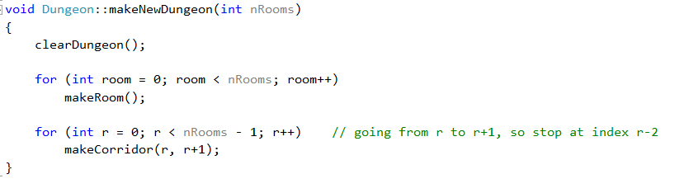
Procedurally Generated Dungeons
Notes:
One option for your core functionality
Remember that you also need some way to make what the dungeon knows into something the TileMap can use.

Slide 12
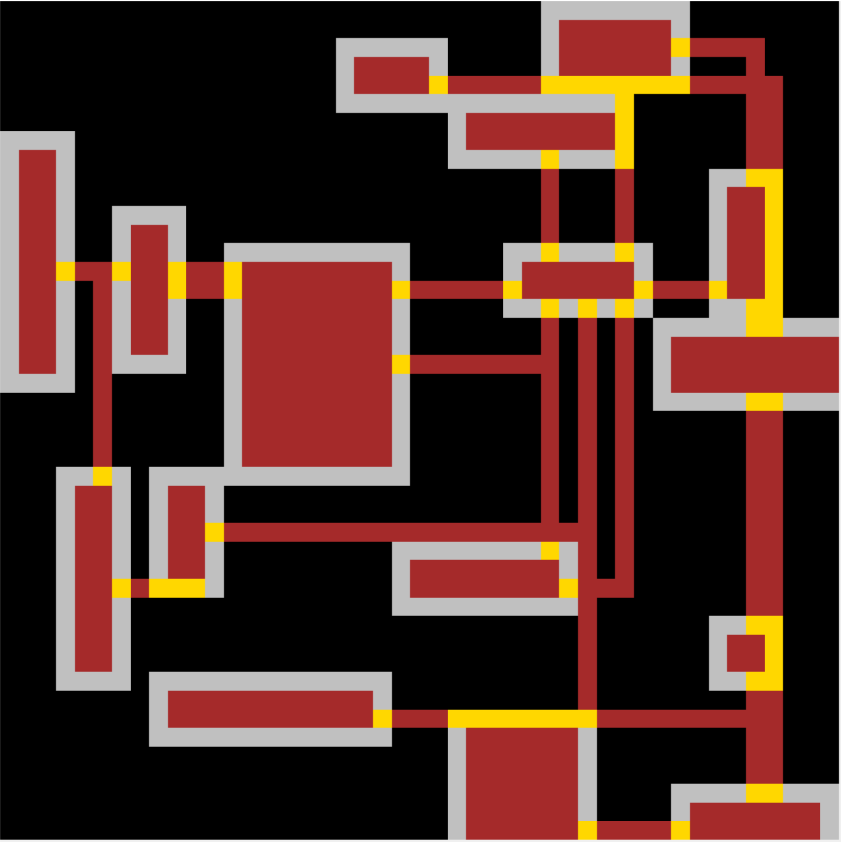
Procedurally Generated Dungeons
Notes:
This is a sufficient dungeon (yellow = door)
Note that where wall and corridor overlap, you get door, making some of these rooms actually alcoves. That is fine
Note also that we don’t worry about walls at the edges – some of these rooms have dirt walls. That’s also fine.
The point is that floor, door and corridor are walkable. Wall, dirt and edge of the world aren’t

Slide 13
Combat
Easiest = turn-based, fight-to-the-death, no ranged weapons
When two enemies collide, they commence battle
Battle is a series of attacks, with each combatant attacking in turn
Battle continues until one combatant is defeated
Characters need:
Some measure of health
Some hit probability
(Optionally) some “amount of damage” probability
Feedback should show the health of both characters at each turn (text is fine).
Notes:
Stuff it all into a while loop.
So char1 hits with some probability and takes some amount of health from char2 if the hit lands.
Then player 2 gets his turn
Then player 1, and so forth until someone’s health goes to 0, at which point, it is dead
Possible extensions include line of sight (e.g. in mine, when the player enters the a room where there is an enemy, the enemy moves toward him) fleeing, chasing, hiding and ranged weapons. Enjoy.

Slide 14
Assignment Spec

